Slide 1
Ask Weber
Session 2
Topic 4
https://askweber.github.io/

Slide 2
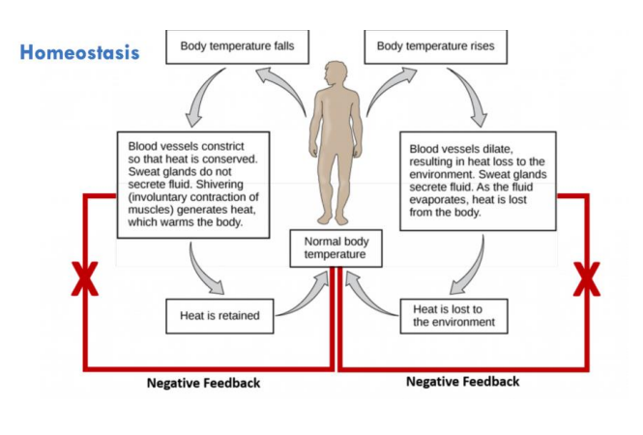
Lecture 4 - Homeostasis
Explain the homeostatic mechanisms the body implements to prevent hyperthermia.
Colloquially, we use ‘physiology’ to describe when systems implement negative feedback loops (i.e. homeostatic mechanisms). What are 2 situations which are physiological positive feedback loops?

Slide 3
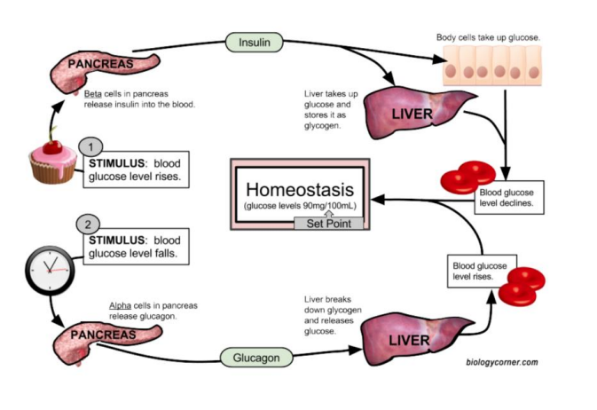
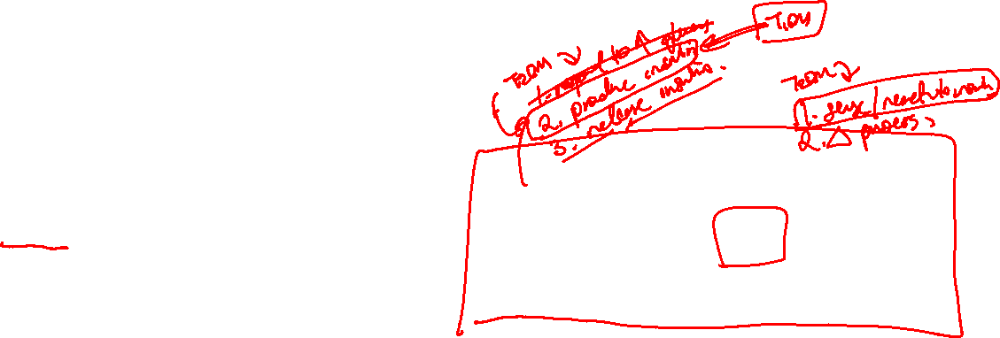
Lecture 4 – glucose homeostasis
In response to eating (and elevated glucose levels in the blood), the pancreatic beta cells tend to activate. Describe the function of the pancreatic beta cells in the maintenance of blood glucose homeostasis.
In diabetes, the homeostatic mechanism of insulin breaks down. Describe some mechanisms through which this could occur.

Slide 4
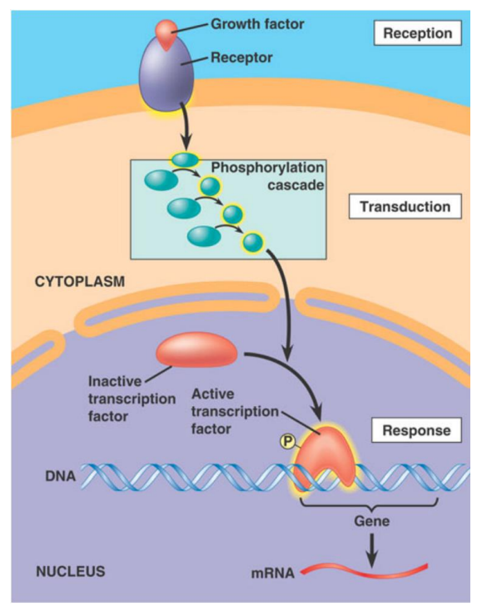

Lecture 4 – Cell signalling
Within certain cells, there are a series of proteins/enzymes named MAP Kinase Kinase Kinase, MAP Kinase Kinase, MAP Kinase. One example is RAS/RAF/MEK/ERK (I learnt this when I did 3rd year physiology in undergrad). The function of these proteins are to phosphorylate each other in order to move a signal from outside of the cell to the inside (Note that kinases work by phosphorylation). What is this part of the cell signalling process called? 1. Within certain cells, there are a series of proteins/enzymes named MAP Kinase Kinase Kinase, MAP Kinase Kinase, MAP Kinase. One example is RAS/RAF/MEK/ERK (I learnt this when I did 3rd year physiology in undergrad). The function of these proteins are to phosphorylate each other in order to move a signal from outside of the cell to the inside (Note that kinases work by phosphorylation). What is this part of the cell signalling process called?

Slide 5
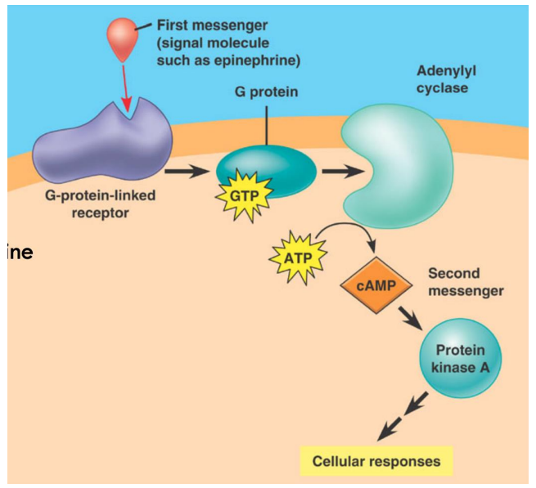
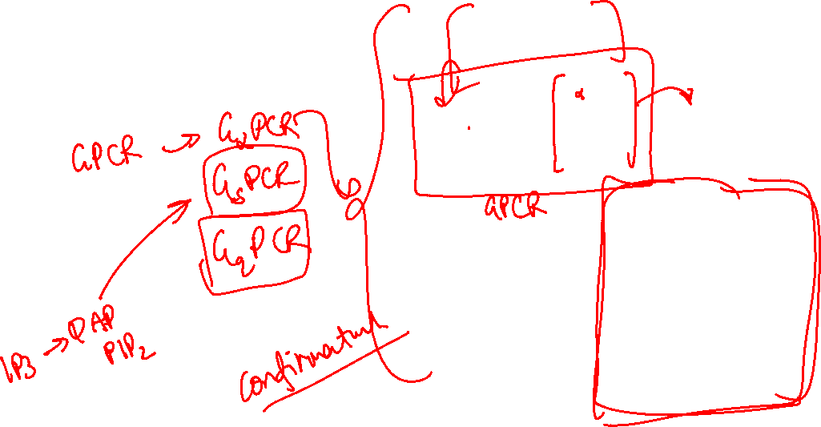
Lecture 4 – Cell signalling
Describe 4 features of a 2nd messenger.
Give 2 examples of secondary messengers.
Explain the mechanism of action of 𝑮𝜶-Protein coupled receptor (𝑮𝜶𝒔𝑷𝑪𝑹)
Notes:
- Low amounts in resting state
• Regulated synthesis
• Regulated destruction
• Act through other proteins

Slide 6
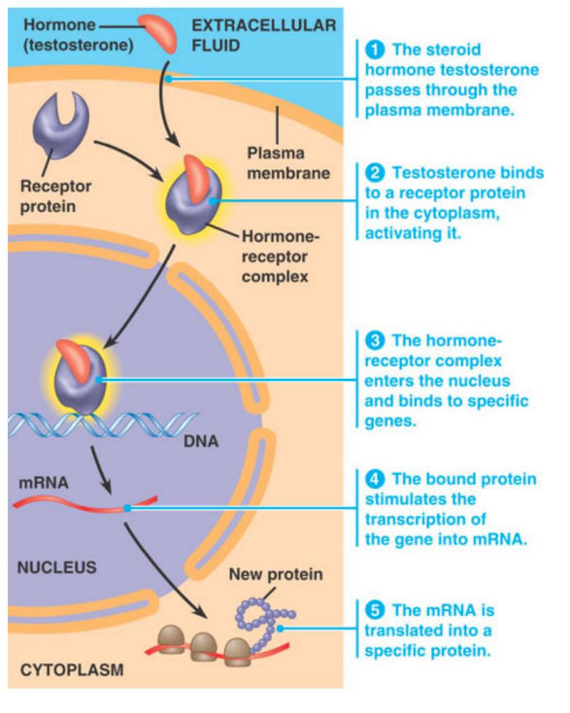
Lecture 4 - Hormones
Describe the differences in signalling mechanisms between a protein hormone (give an example) and a steroid hormone (give an example).
Notes:
Insulin, glucagon, thyrocalcitonin, pituitary hormones, and hypothalamic hormones are examples of protein hormones. They are also known as polypeptide hormones.
steroid hormones include mineralocorticoid and glucocorticoids

